Slide 1






Baderia Global Institute of Engineering and Management, Jabalpur, Madhya Pradesh 482002
Problem Statement:
AI tutors and content recommendation systems: Intelligent Chrome extension tools that provide personalized guidance and resources, enhancing the learning process.
Team Name: TechMatrix Solvers
Team Leader Name:
Abhay Gupta
Institute Name: Shri Ram Institute of Technology Jabalpur
Project Name: Learning Legion
Team Leader Email ID: contact2abhaygupta@gmail.com

Slide 2





Team TechMatrix Solvers
Mayank Das Bairagi
Aditya Vishwakarma
Aditi Lakhera
ABHAY GUPTA
BrahmaX 1.0

Slide 3

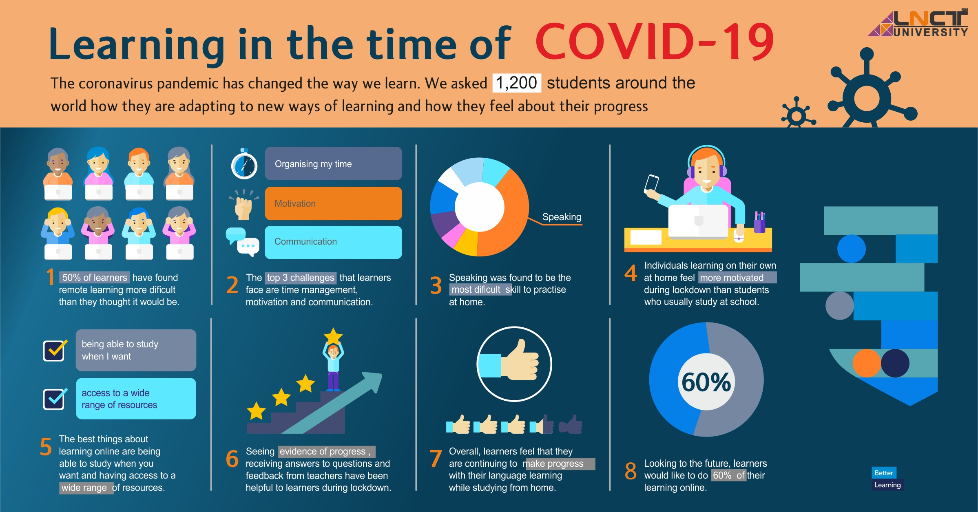
Problem Statement
TechMatrix Solvers
Problem Statement EdTech E1. AI tutors and content recommendation systems: Intelligent tools that provide personalized guidance and resources, enhancing the learning process. SOLUTION Maintaining learning continuity. 1. Learning Management System (LMS) Portal. (Personalised) using ML Models.
2. Chrome Extension- -Browser LockDown -AI Chrome Extension
BrahmaX 1.0

Slide 4
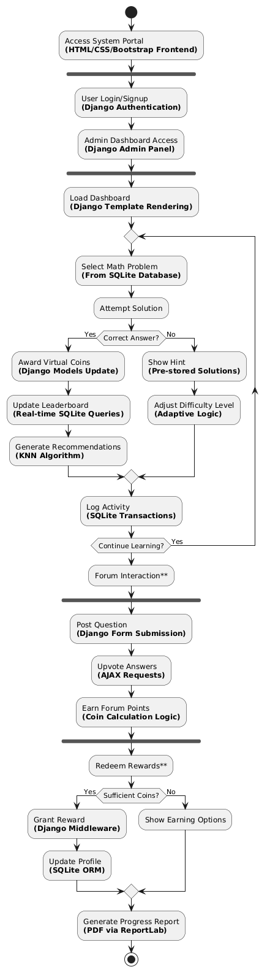
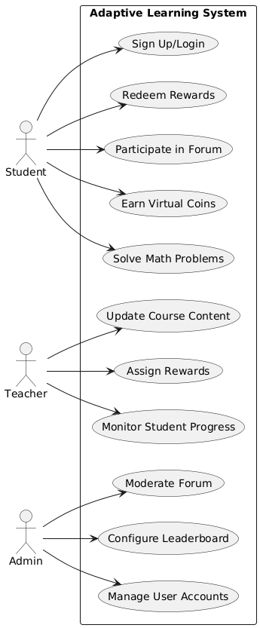
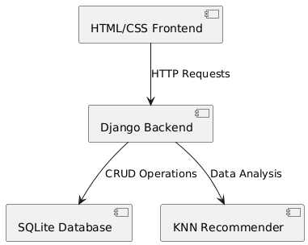
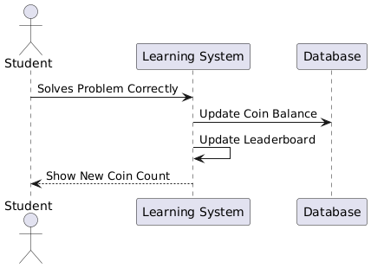
Technical Solution
TechMatrix Solvers
Supporting Images/Flowchart
Idea Approach
BrahmaX 1.0

Slide 5
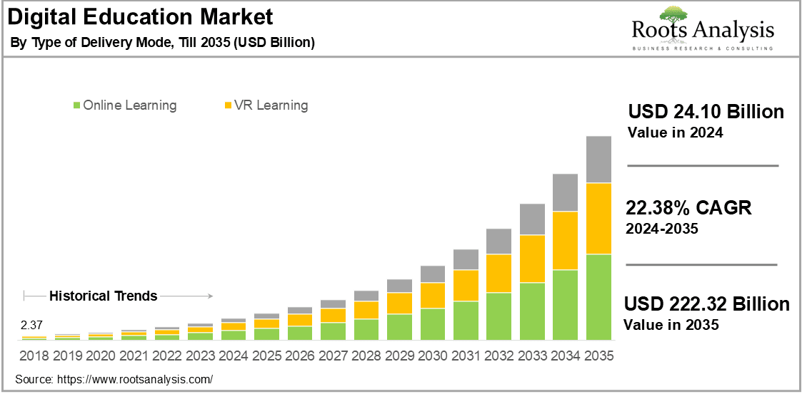

Market Reach
TechMatrix Solvers
BrahmaX 1.0

Slide 6
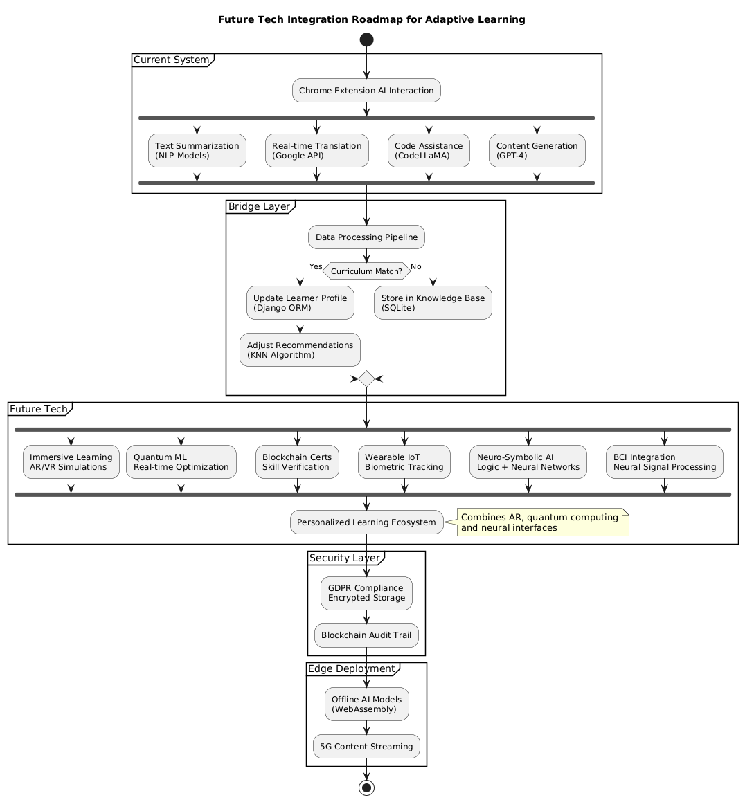
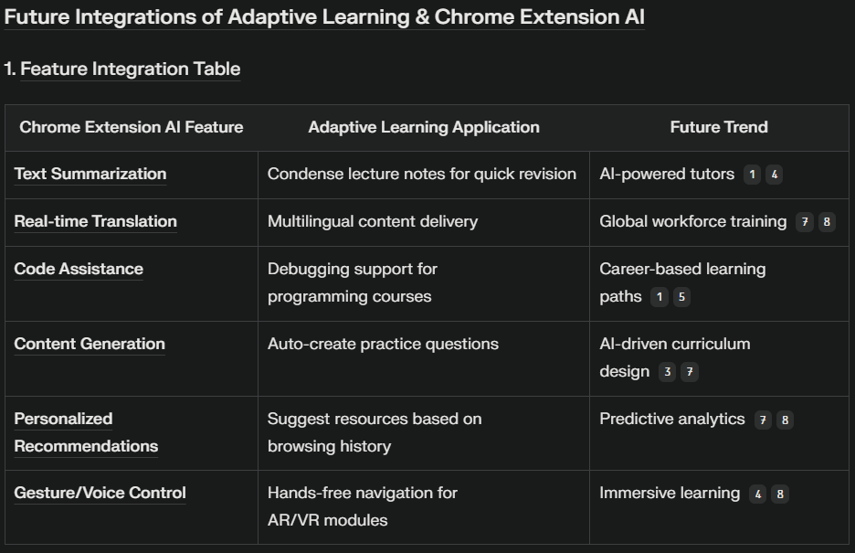
Future Integration
TechMatrix Solvers
BrahmaX 1.0

Slide 7

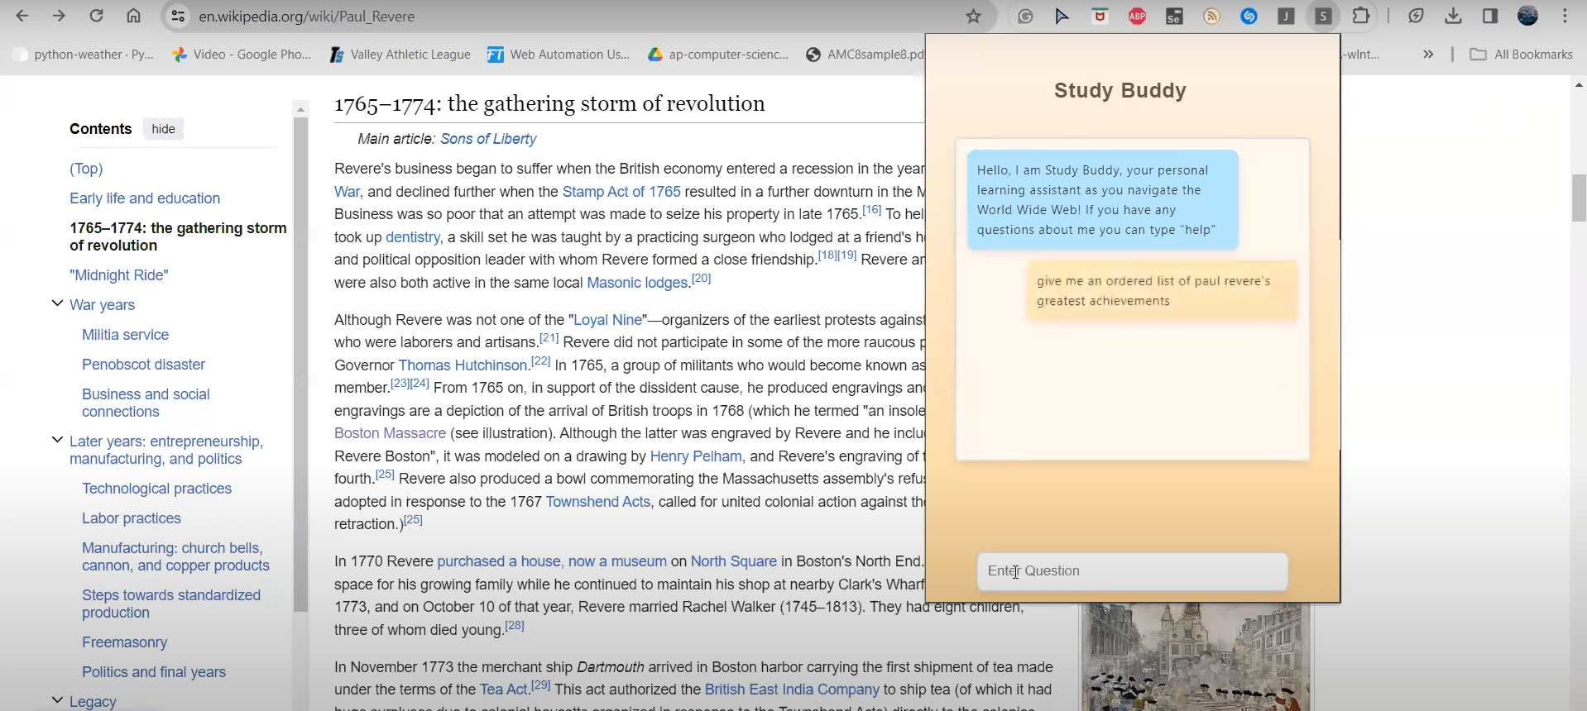
TechMatrix Solvers
Prototype of our Project
Credits Abhay Gupta TechMatrix Solvers Team Lead
BrahmaX 1.0

